Slide 1


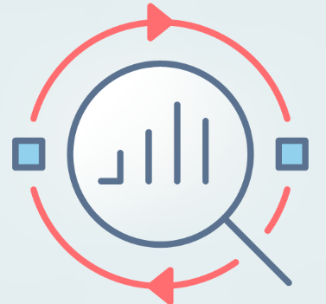


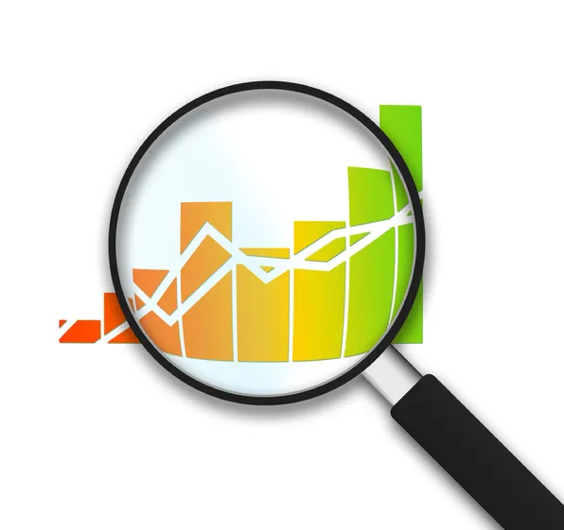


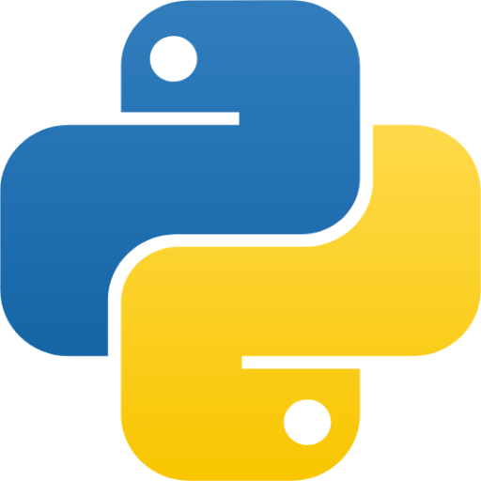










My Business Analytics Odyssey at Macquarie University
Chose Business Analytics for a data-driven future.
Excitement and apprehension about the unknowns ahead.
Skills Acquired:
R & Statistics: Advanced data analysis techniques
SQL & Tableau: Database querying and visual storytelling
Team working: Collaborative FinTech assignment
Python: Machine learning and predictive analytics
Time management: Fulltime work & study challenge
Embarking on the Journey
First semester: Building the Foundation
Skills Acquired:
Econometrics: Groundwork for advanced analysis
Finance: Informed business decisions
Data Science: Specialized analytics
Calculus & Linear Algebra: Analytical problem-solving
Skills Acquired:
Applied Econometrics: Enhanced analytical forecasting
Soft Skills for Data Management: Effective data handling and team communication
Python: Advanced predictive analytics techniques
Statistical Theory: Comprehensive understanding of statistical frameworks
Time management: Fulltime work & study challenge
Diving Deeper
Second Semester
Embraced challenging curriculum
Nurtured soft skills
Mastered tools: R, Python, SQL, Tableau, Power BI, Gretl
Overcame academic hurdles
Time management & resilience
Harnessing skills for real-world applications
Continuous learning aspiration
Bridging university insights with industry needs
Anticipation of future BA advancements
Refining Analytical Prowess
The third semester
Commencing the last semester, equipped with the knowledge of the past, I venture into advanced analytical realms.
Skills To Be Acquired:
Advanced Econometrics: Exploring specialized topics to enhance analytical finesse.
Analytical Project Management: Spearheading the 'Business Analytics Project', harnessing past learnings.
Generalized Models: Mastering nuanced statistical techniques for diverse data structures.
Visualization Expertise: Elevating data presentation through advanced statistical graphics.
Growth Beyond Academia
As courses conclude, personal growth blossoms. The lessons were more than just academic.
Gazing Forward
With academia almost behind, I stand on the cusp of the professional realm, armed with knowledge and experiences.
Embarking on Advanced Analytics
The final semester

